Slide 1

ELECTRICAL PRESENTATION
COLLISION WARNING USING 2D-LIDAR
(USING MATLAB SIMULATOR)
GROUP-5
TEAM MEMBERS:
Poorani Ayswariya PS_21134
Pranav Raj S_21135
P Yagnitha_21138
Sarrvesh N_21146
Sidesh Sundar S_21150

Slide 2
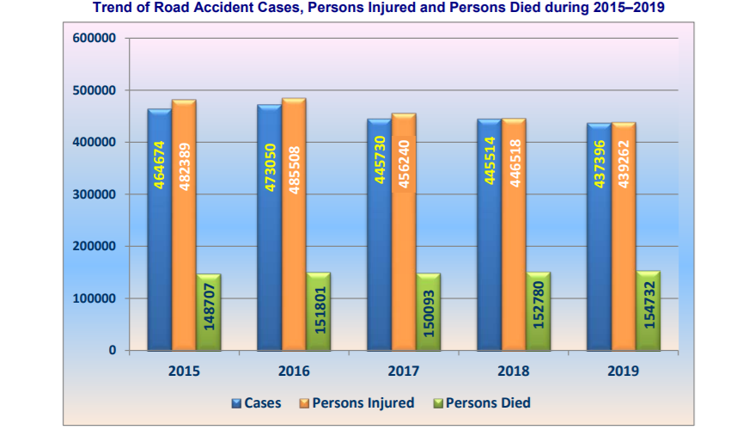
INTRODUCTION
1
Road accidents have been major problem in India because in past 5-years 2,363,031 (2015-2019) of road accidents have occurred and 7,47,361 deaths have took place. Each year, about 3% to 5% of country’s GDP was invested in road accidents.

Slide 3
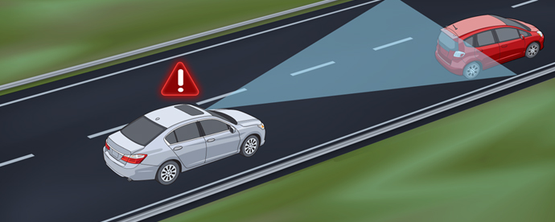
WHY COLLISION WARNING ?
2
In order to reduce road accident, collision warning system has been developed and are being used in a wide range in different areas and under very different circumstances. Typical sensors used to detect obstacles are radar, LIDAR or vision sensors.

Slide 4
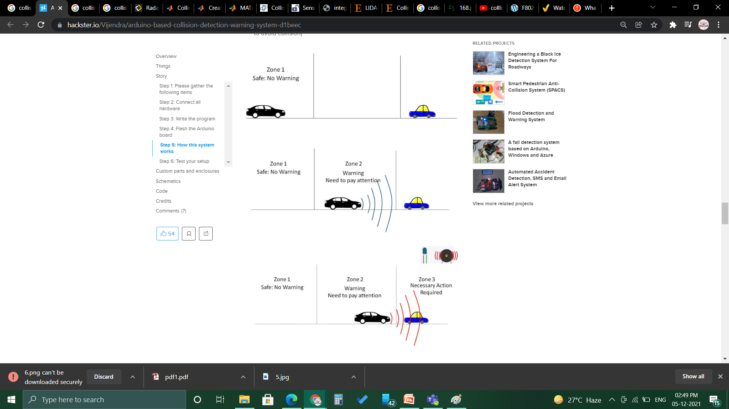
WHAT IS COLLISION WARNING SYSTEM?
3
Collision warning system is one of the principal components of safe driving. This system will find the obstacle reaching near a vehicle and alert the driver accordingly so that collision can be avoided.

Slide 5
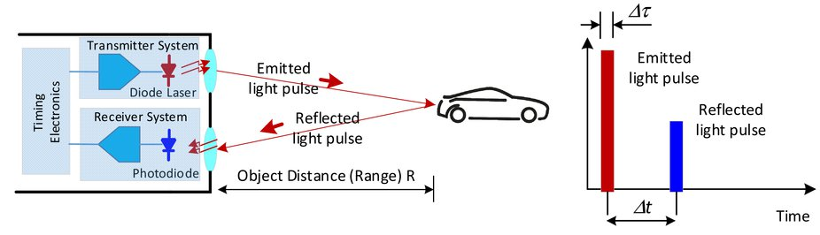
LIDAR SYSTEM
4
LIDAR stands for (Light Detection And Ranging Sensor) .
LIDAR is a remote sensing technology which measures the distance of an object by illuminating the target with laser and then analyzing the reflected light. This allows the sensor to calculate the correct distances between objects.
For a 2D-LIDAR sensor, only one laser beam is necessary. Indeed, it will pulse based on a spin movement and collect horizontal distance to the targets to get data on X- and Y- axes.

Slide 6
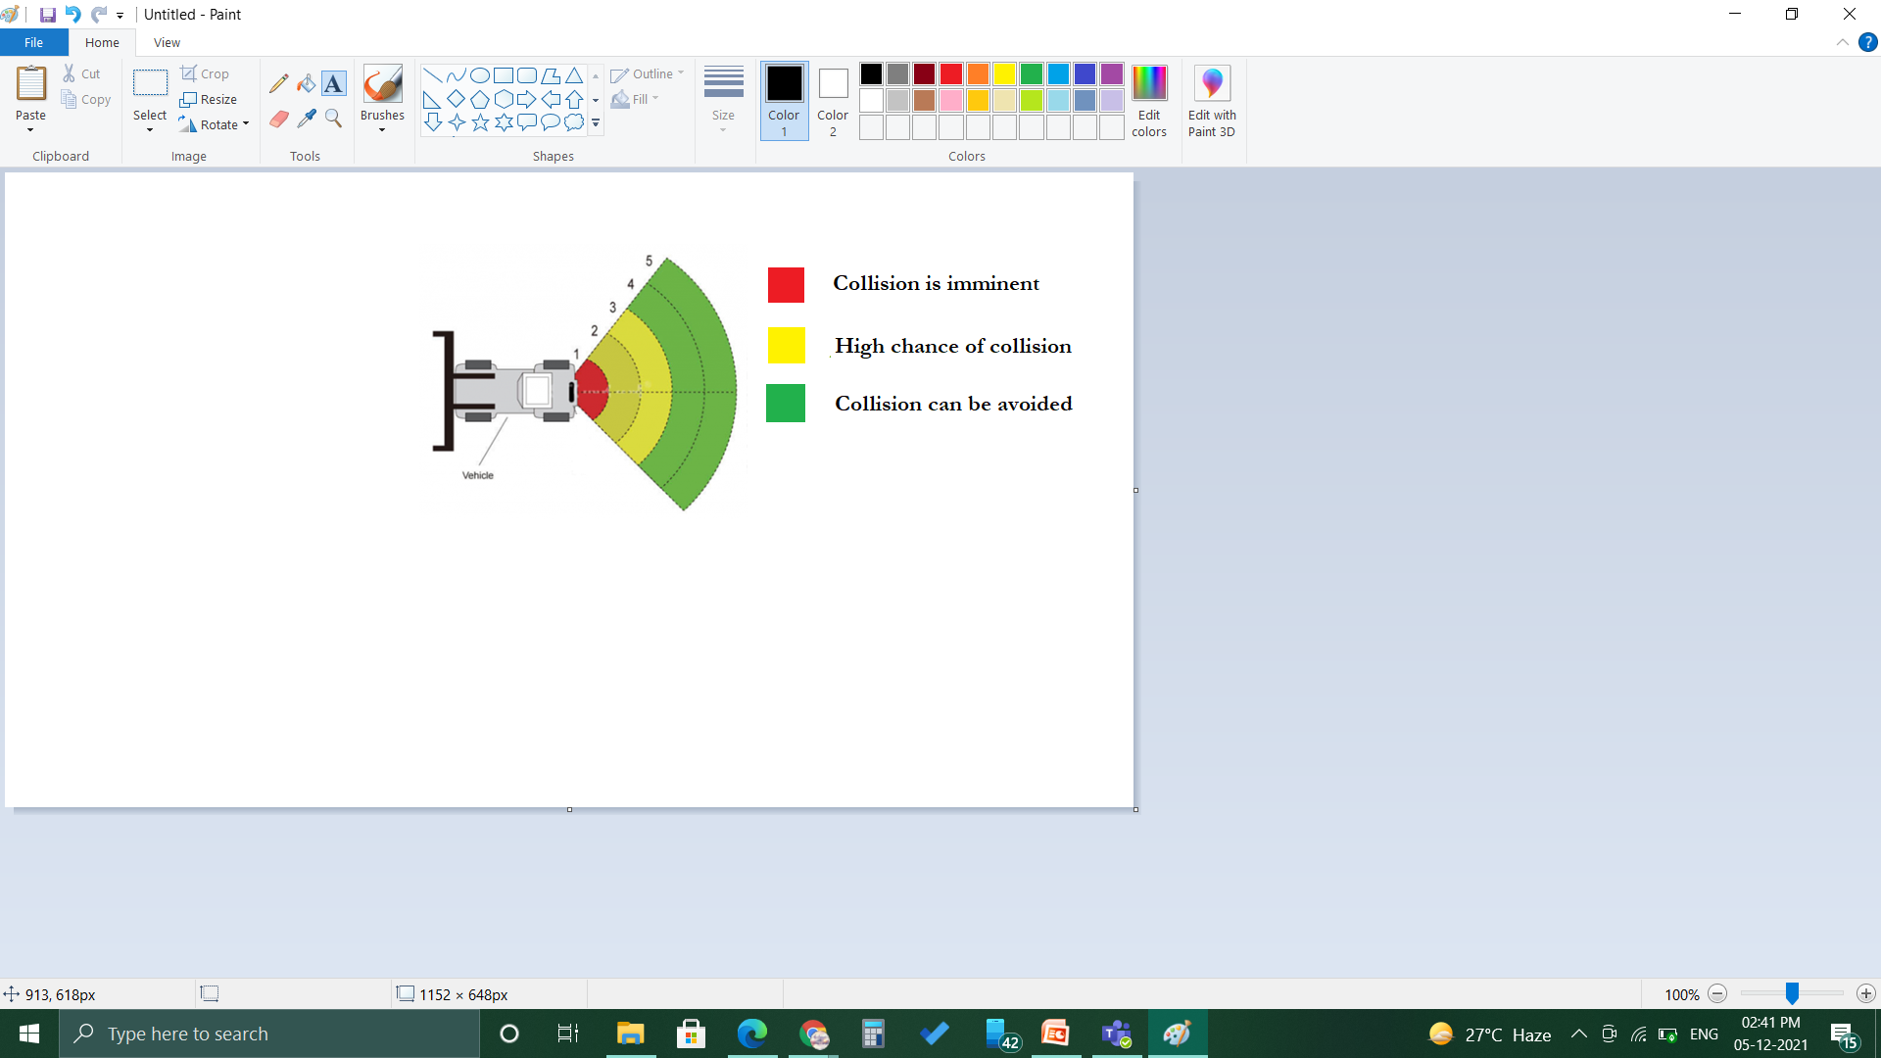
2D-LIDAR SYSTEM
5
In this project we used 2D-LIDAR (Light Detection And Ranging Sensor) to make collision warning system. Here, the warning will be sent to the driver depending on the distance of obstacle.

Slide 7


WORK FLOW
6
The workflow of our project has been classified into four steps. They are explained below :
SIMULATE WORKSHOP
GENERATE
DATA
DETECT
OBSTACLES
PROVIDE
WARNING

Slide 8
OVERVIEW
7
Logistics warehouses are increasingly mounting 2-D LIDARS on automatic guided vehicles (AGV) for navigation purposes, due to the affordability, long range, and high resolution of the sensor. The sensors assist in collision detection, which is an important task for the safe navigation of AGVs in complex environments.
Here, we created a robot workspace with many obstacles, generate 2-D LIDAR data, detect obstacles, and provide a warning before an impending collision. So that collision could either be avoided or at-least it can be managed without huge impact.

Slide 9
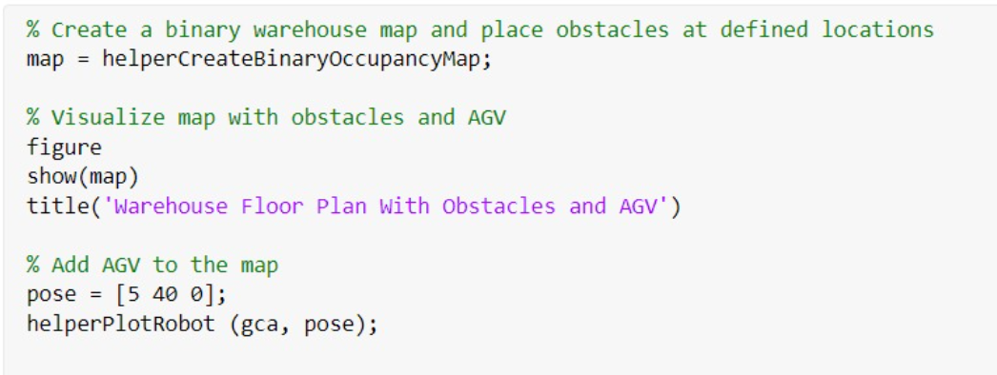
CREATING WAREHOUSE
To represent the environment of the robot workspace, define a binaryOccupancyMap (Navigation Toolbox) object that contains the floor plan of the warehouse. Each cell in the occupancy grid has a logical value. An occupied location is represented as 1 and a free location is represented as 0. You can use the occupancy information to generate synthetic 2D LIDAR data.
CODE FOR CREATING WAREHOUSE :

Slide 10
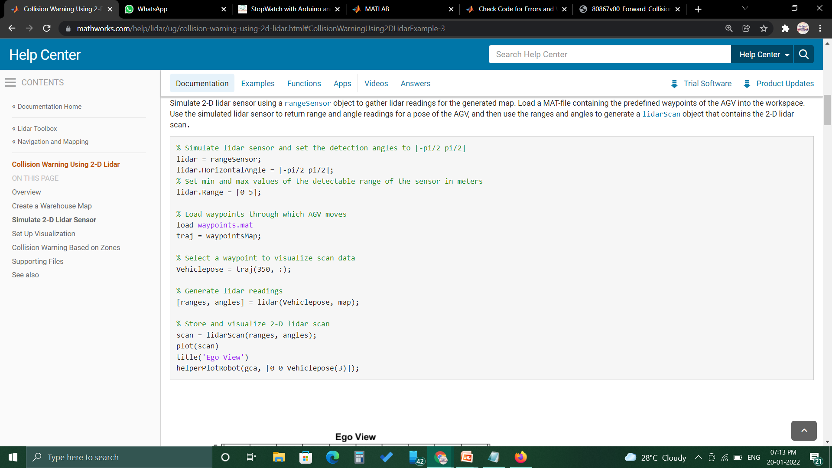
SIMULATE 2D-LIDAR SENSOR
In order to simulate a 2-D LIDAR sensor, a range sensor (object to gather LIDAR readings for the generated map) is begin used.
We have used the simulated LIDAR sensor to return range and angle readings for a pose of the AGV and then used the ranges and angles to generate a LIDAR SCAN object that contains the 2-D LIDAR scan.
CODE FOR SIMULATING 2D-LIDAR SENSOR:

Slide 11


Slide 12
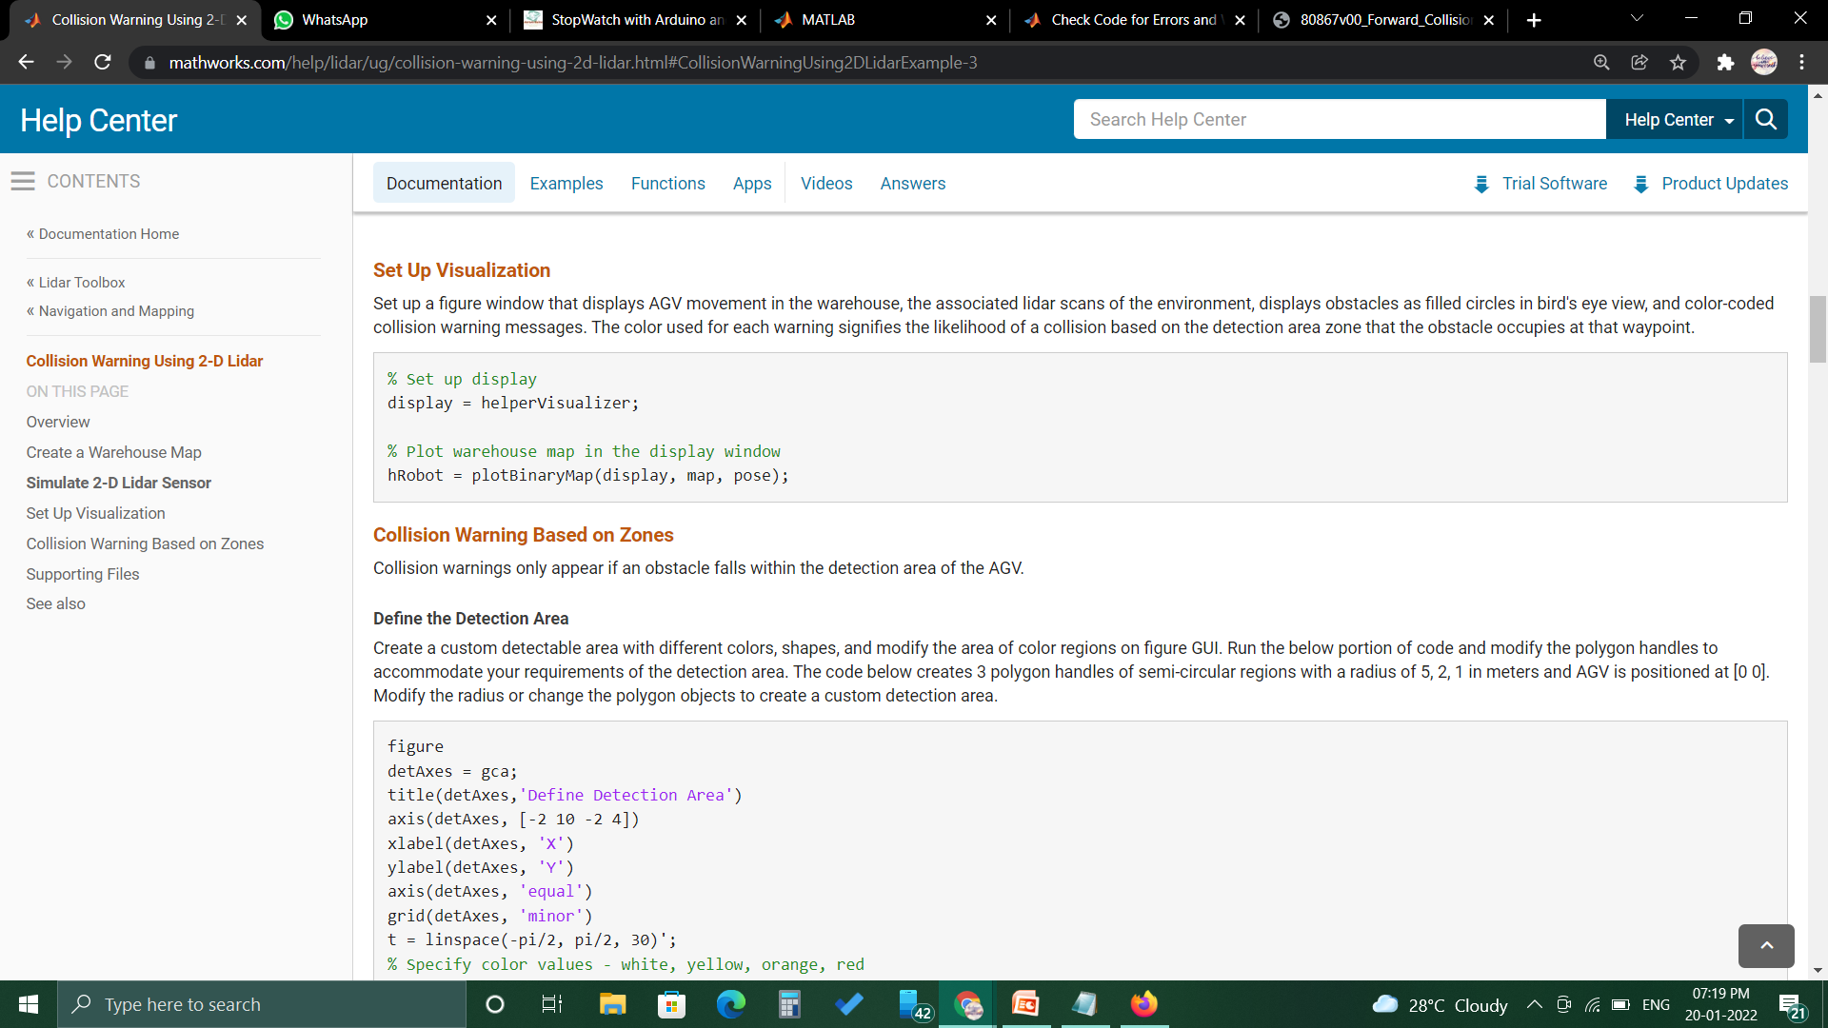
SETTING UP VISUALISATION
Set up a figure window that displays AGV movement in the warehouse, the associated LIDAR scans of the environment, displays obstacles as filled circles in bird's eye view, and color-coded collision warning messages. The color used for each warning signifies the likelihood of a collision based on the detection area zone that the obstacle occupies at that waypoint.
CODE FOR SETTING UP VISUALISATION:

Slide 13
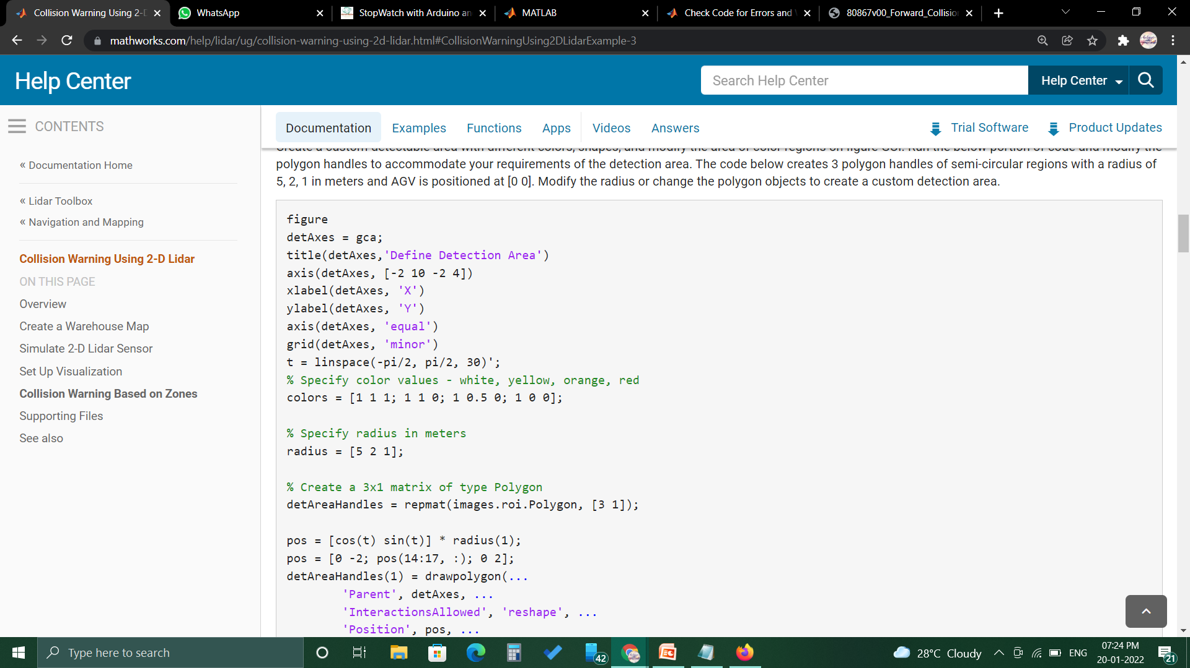
Collision Warning Based on Zones:
Collision warnings only appear if an obstacle falls within the detection area of the AGV.
CODING FOR WARNING BASED ON ZONES:

Slide 14
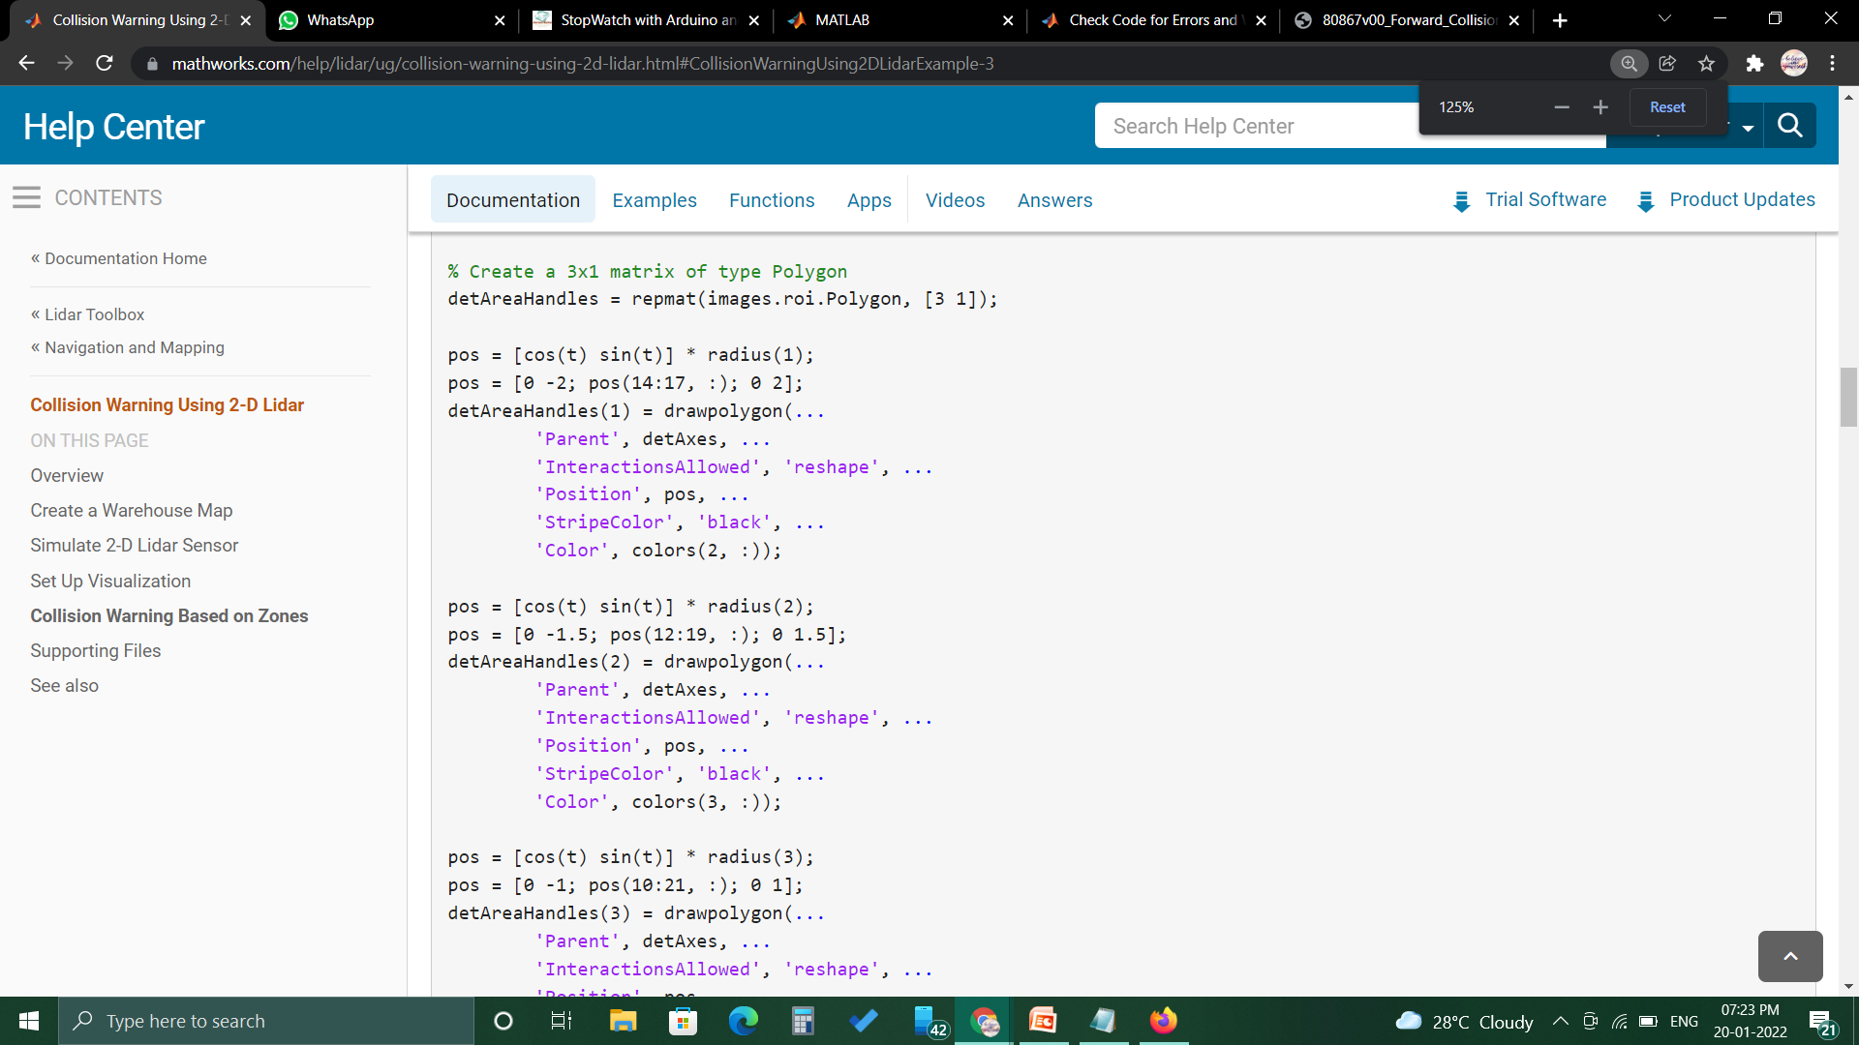

Slide 15
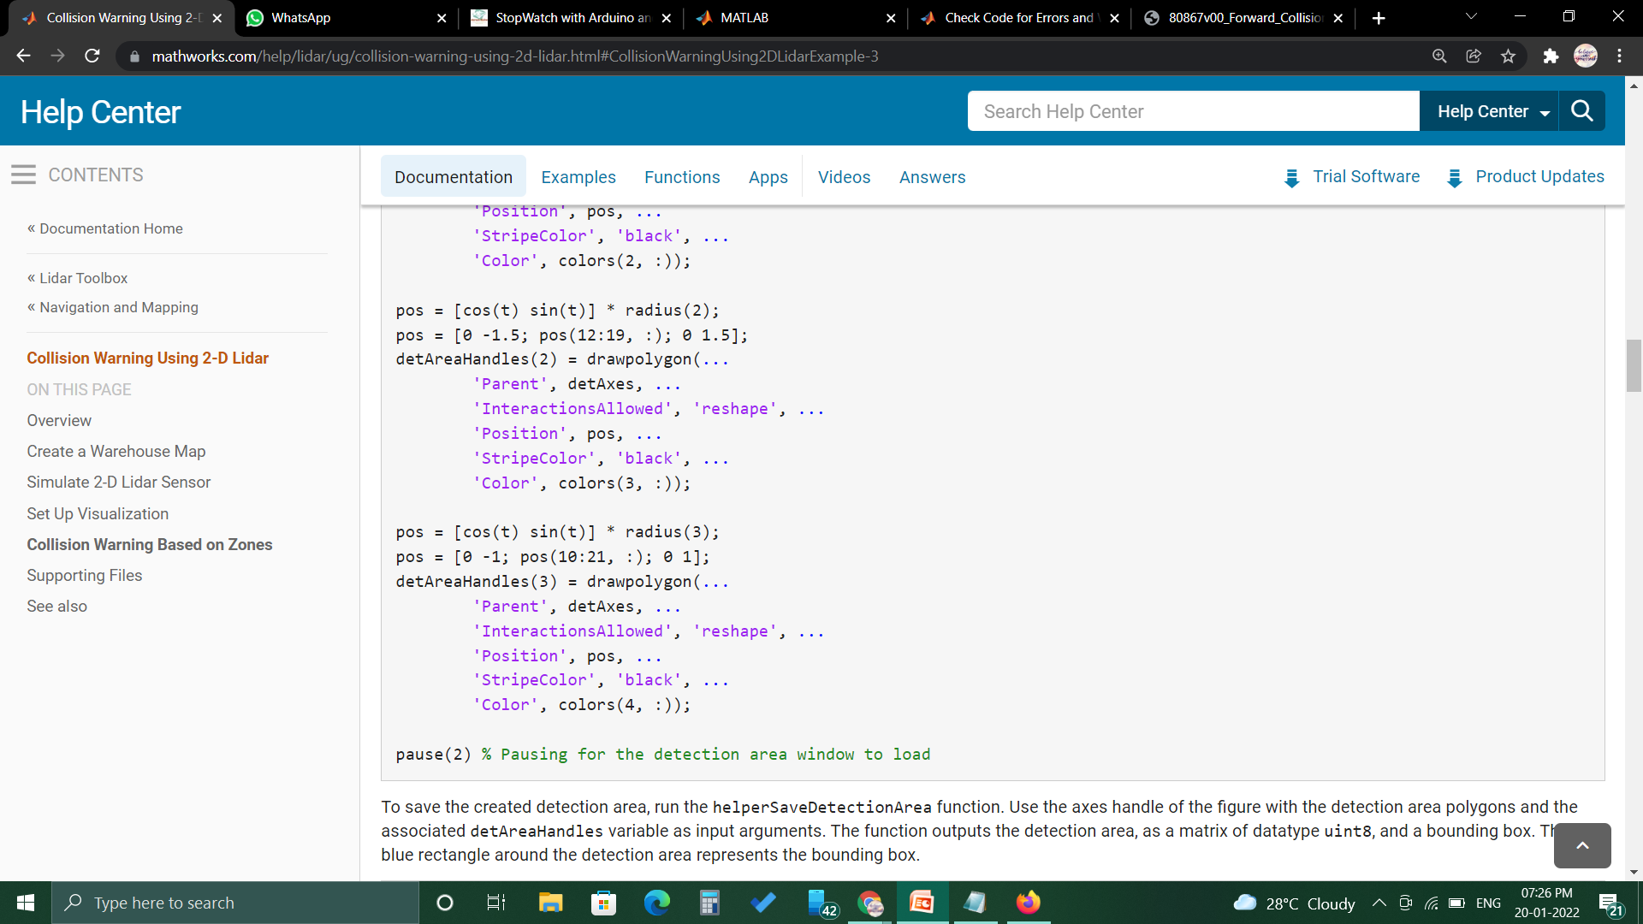
To save the created detection area, run the helperSaveDetectionArea function.
Use the axes handle of the figure with the detection area polygons and the associated detAreaHandles variable as input arguments.

Slide 16
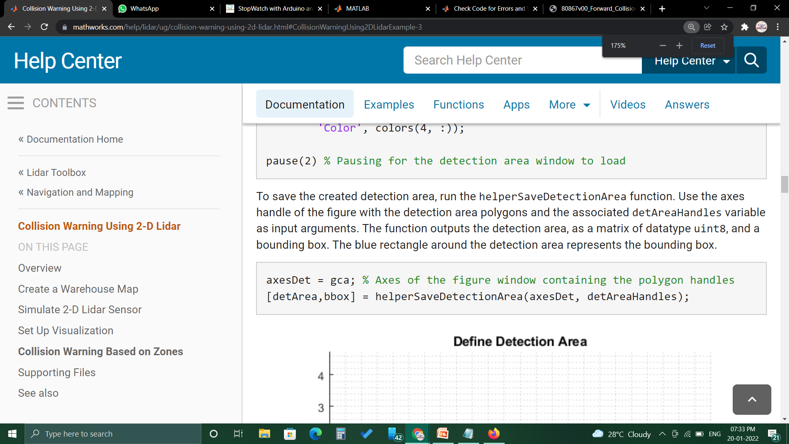
The function outputs the detection area, as a matrix of datatype unit8, and a bounding box.
The blue rectangle around the detection area represents the bounding box.
CODE:

Slide 17
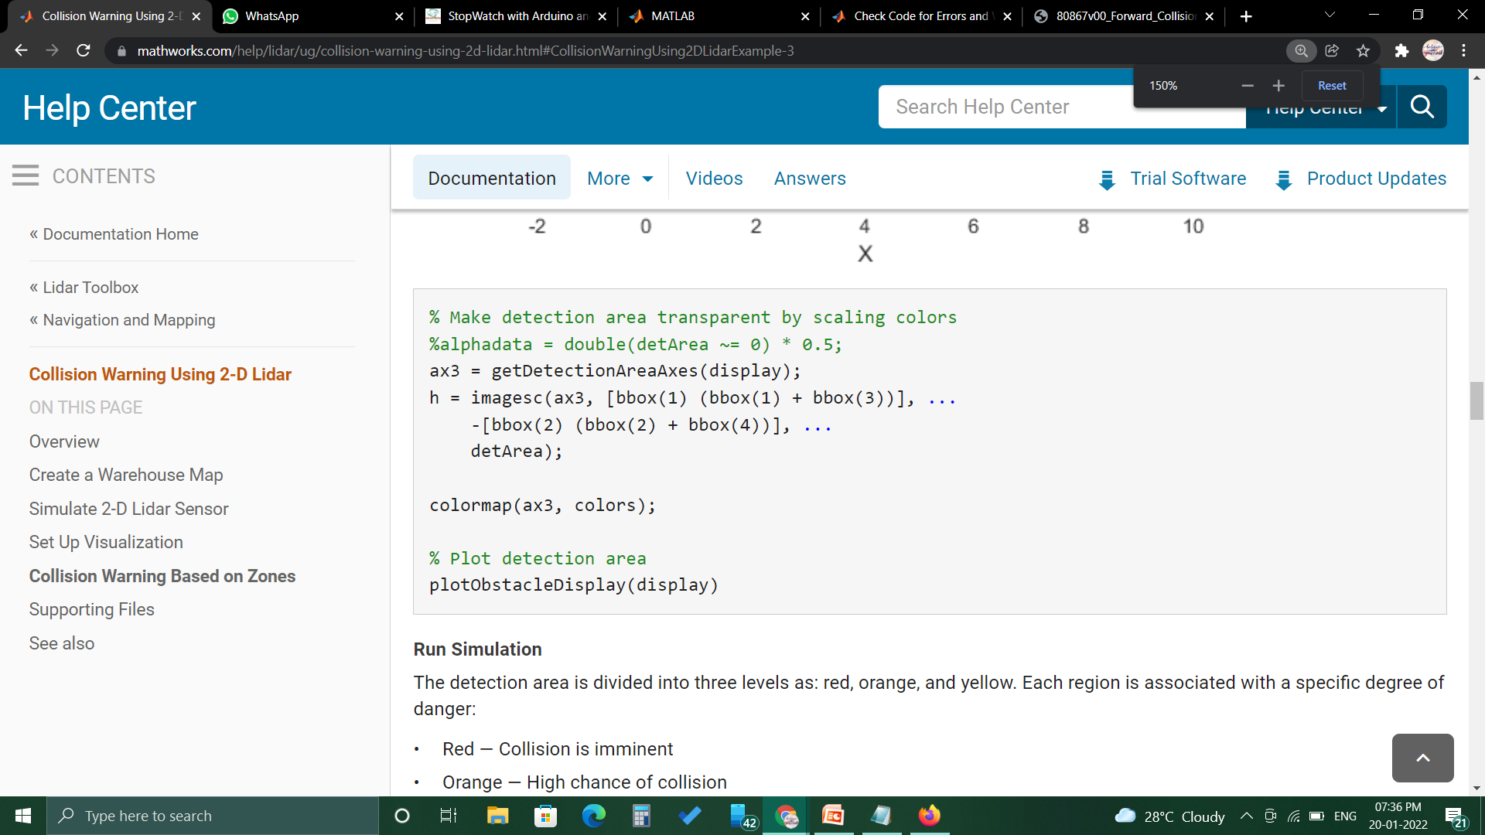
CODE:

Slide 18
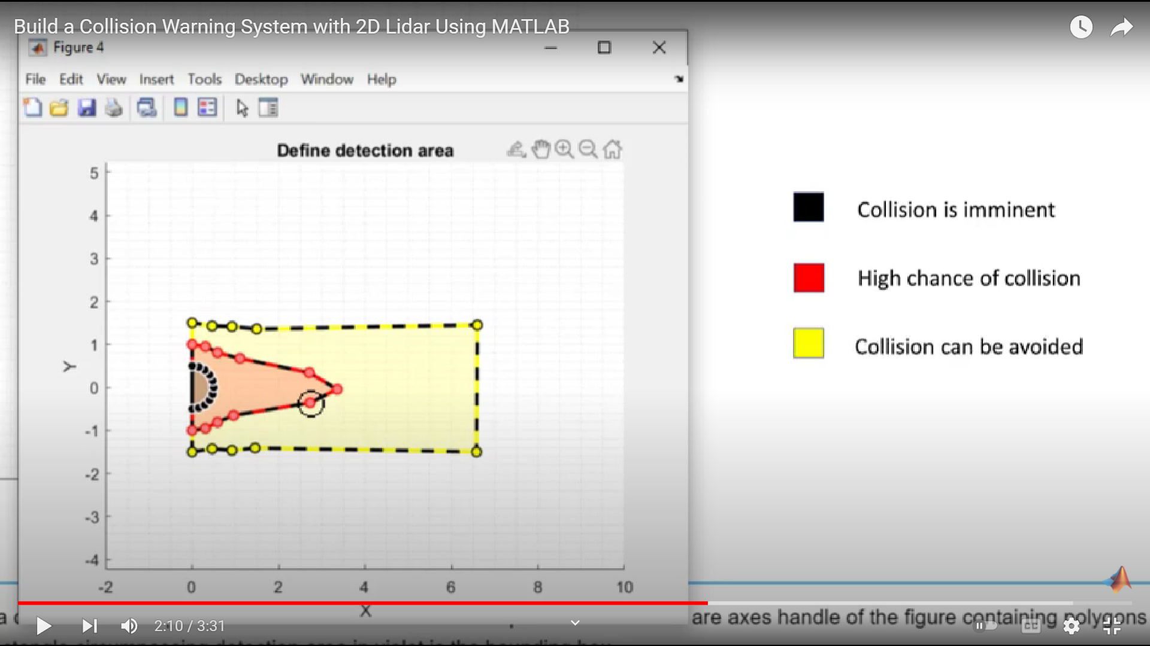
Run Simulation :
The detection area is divided into three levels as: red, orange, and yellow. Each region is associated with a specific degree of danger:
Red — Collision is imminent
Orange — High chance of collision
Yellow — Apply caution measures

Slide 19
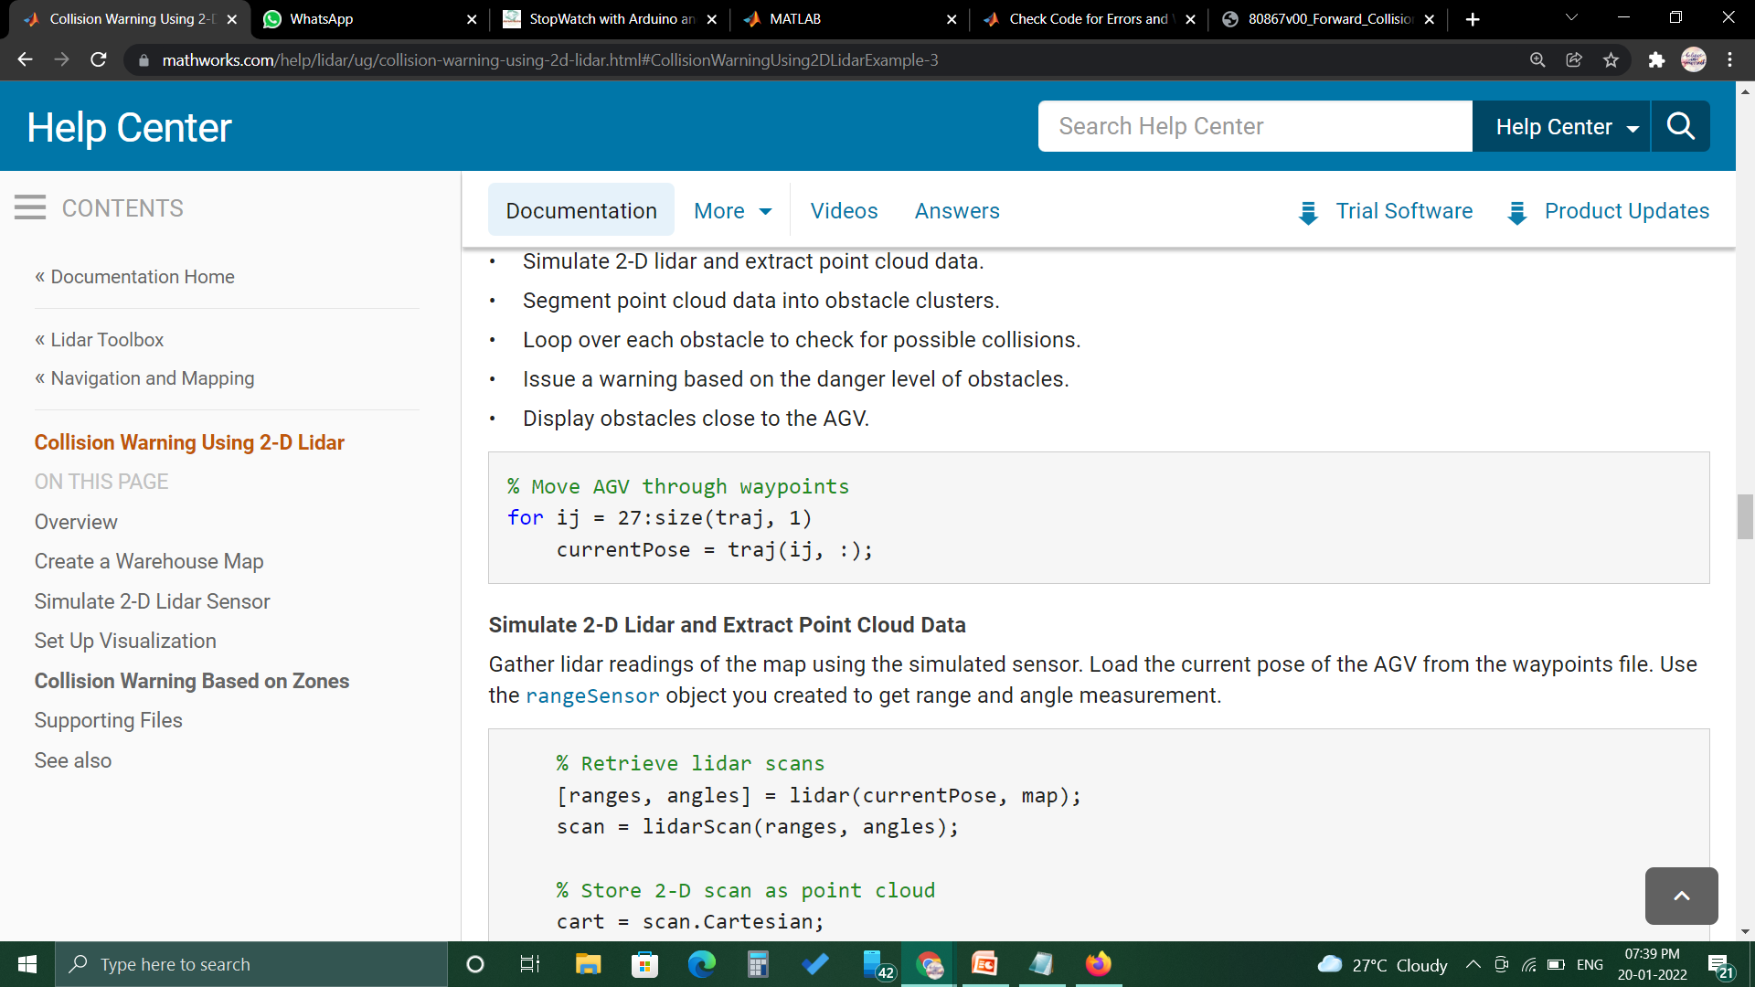
Obstacles that do not fall within the detection range are at safe distance from AGV. These are the primary steps involved in collision warning:
Simulate 2-D lidar and extract point cloud data.
Segment point cloud data into obstacle clusters.
Loop over each obstacle to check for possible collisions.
Issue a warning based on the danger level of obstacles.
Display obstacles close to the AGV.
CODE FOR MOVING AGV THOUGH WAY POINTS :

Slide 20
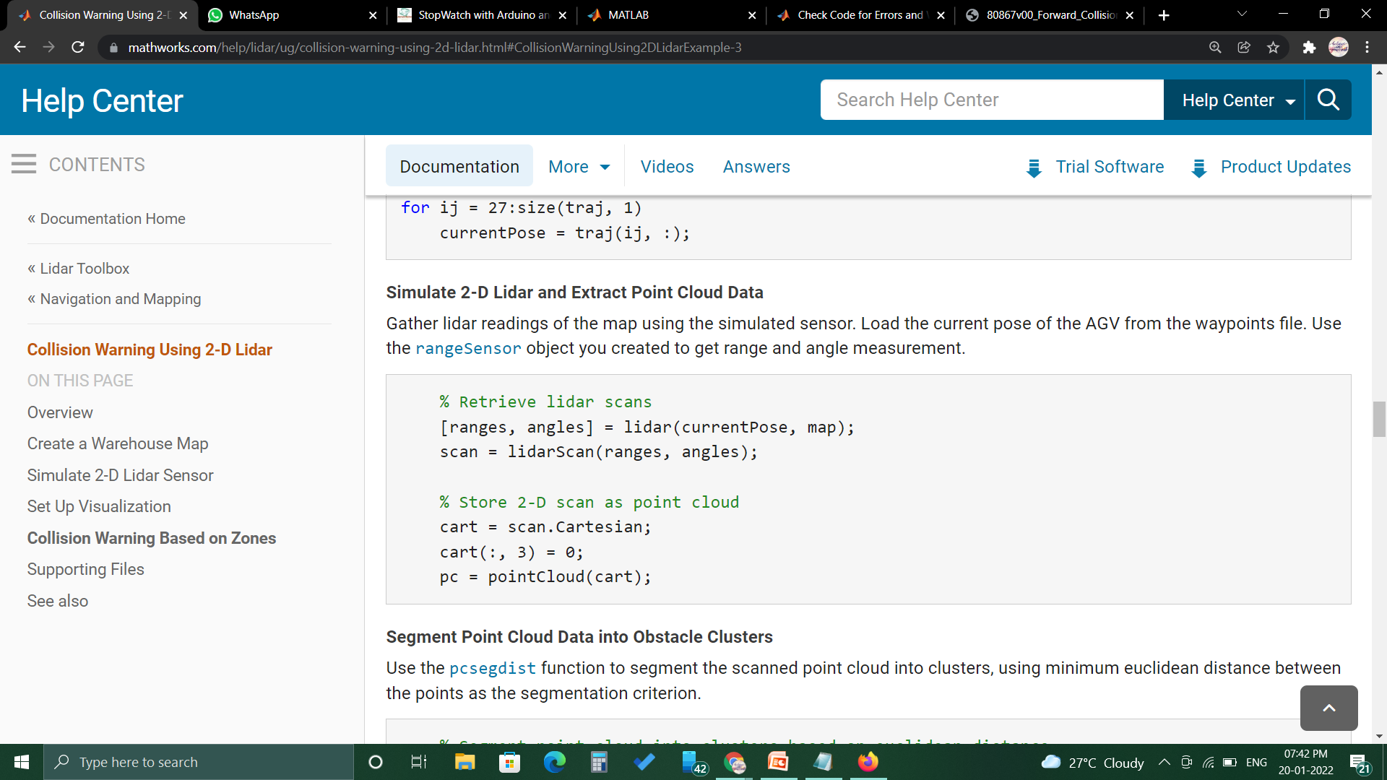
Simulate 2-D Lidar and Extract Point Cloud Data:
Gather LIDAR readings of the map using the simulated sensor. Load the current pose of the AGV from the waypoints file. Use the rangesensor object you created to get range and angle measurement.
CODE:

Slide 21
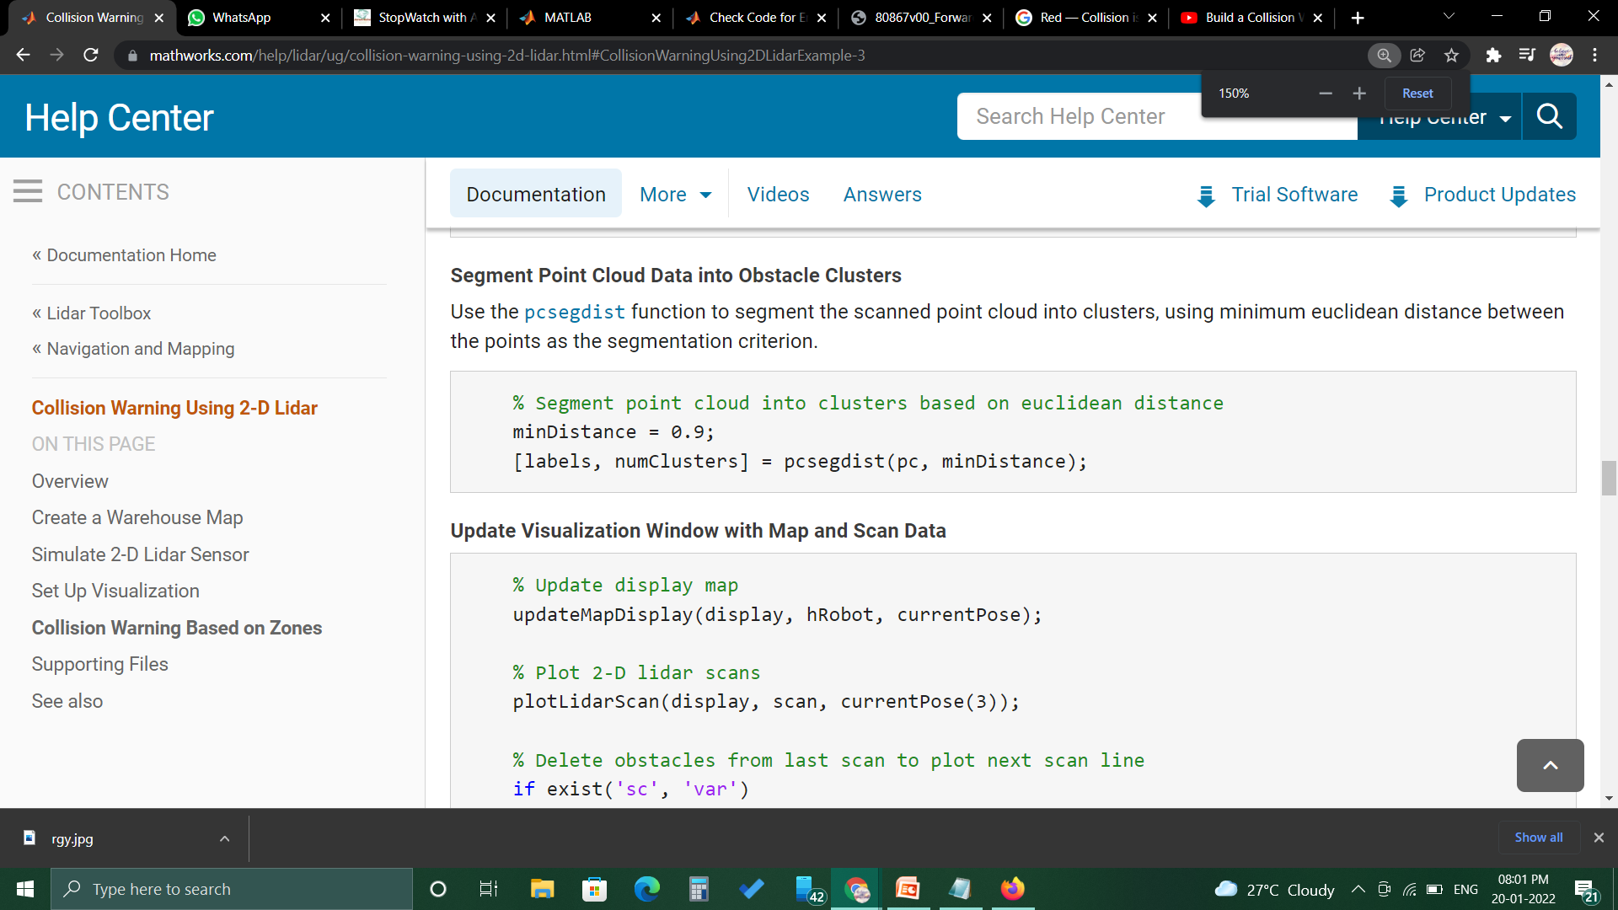
Segment Point Cloud Data into
Obstacle Clusters:
Use the pcsegdist function to segment the scanned point cloud into clusters, using minimum euclidean distance between the points as the segmentation criterion.
CODE:

Slide 22
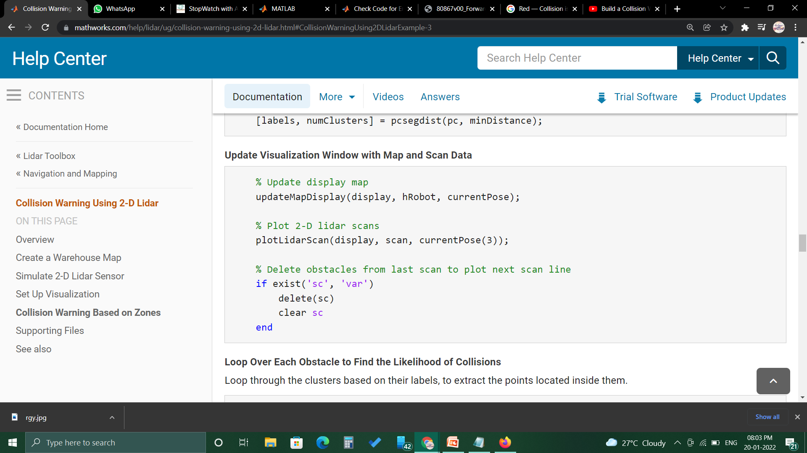
Update Visualization Window with Map and Scan Data:

Slide 23
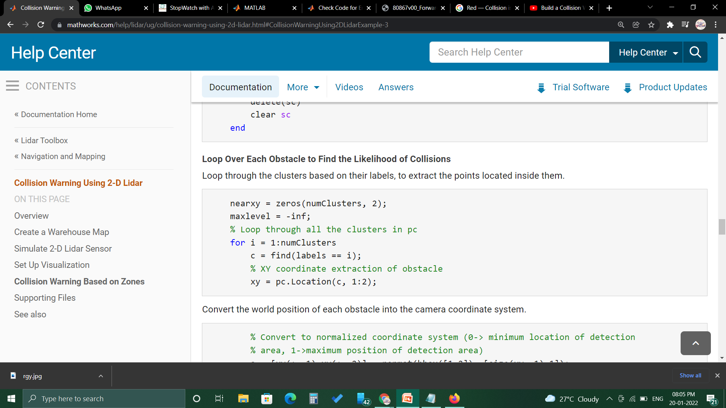
Loop Over Each Obstacle to Find
the collisions:
Loop through the clusters based on their labels, to extract the points located inside them.
CODE:

Slide 24
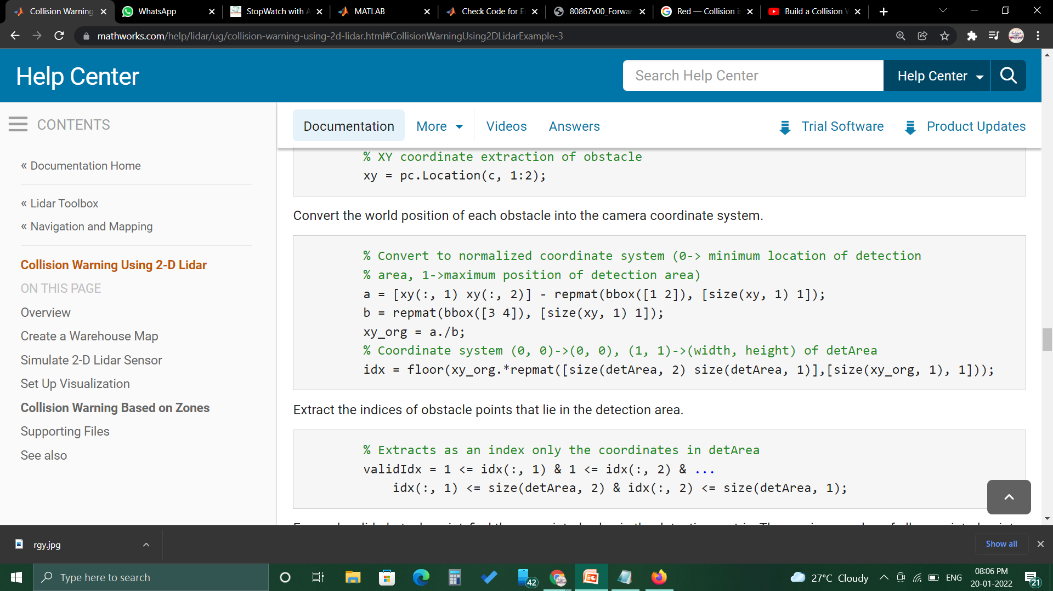
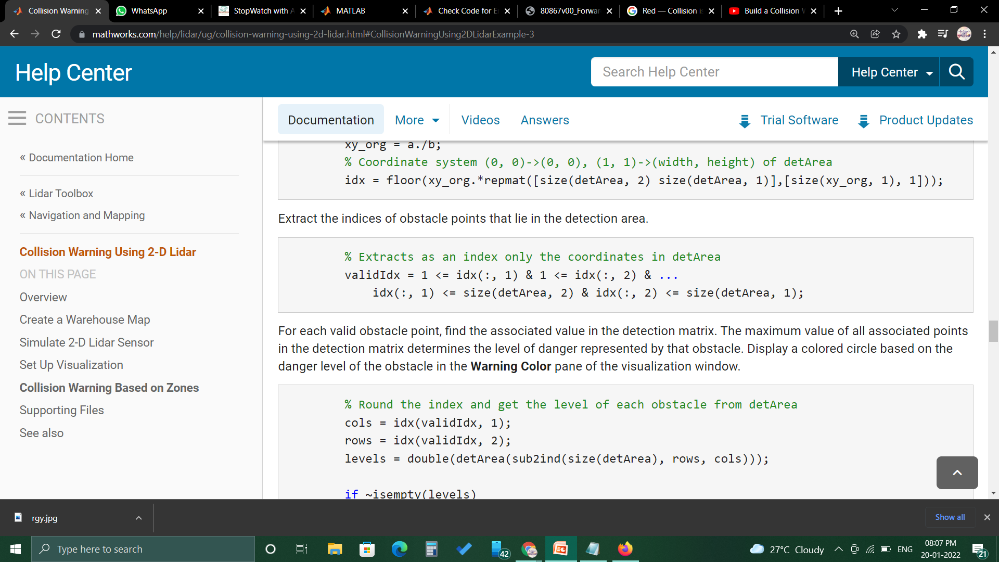
Convert the world position of each obstacle into the camera coordinate system.

Slide 25
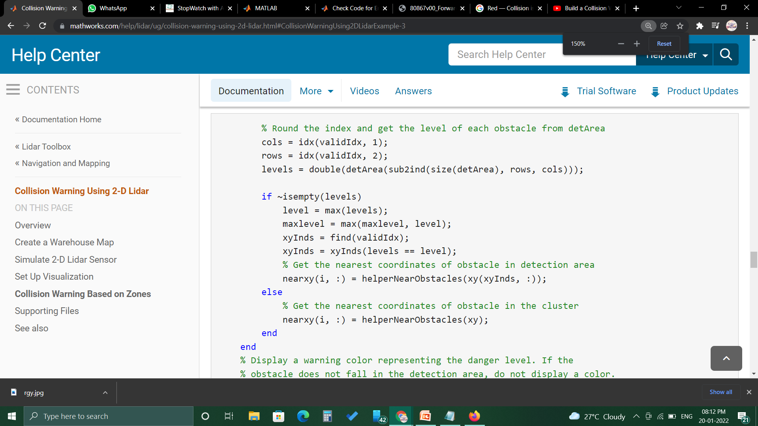
The maximum value of all associated points in the detection matrix determines the level of danger represented by that obstacle.

Slide 26
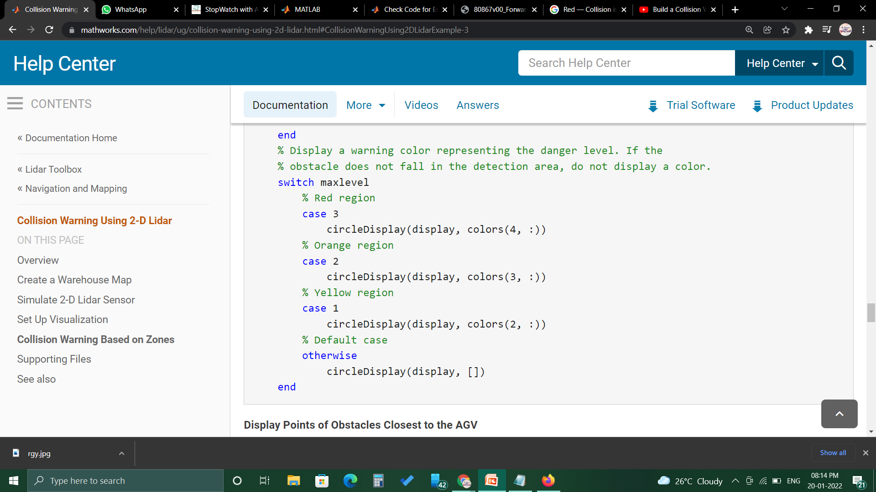

Slide 27
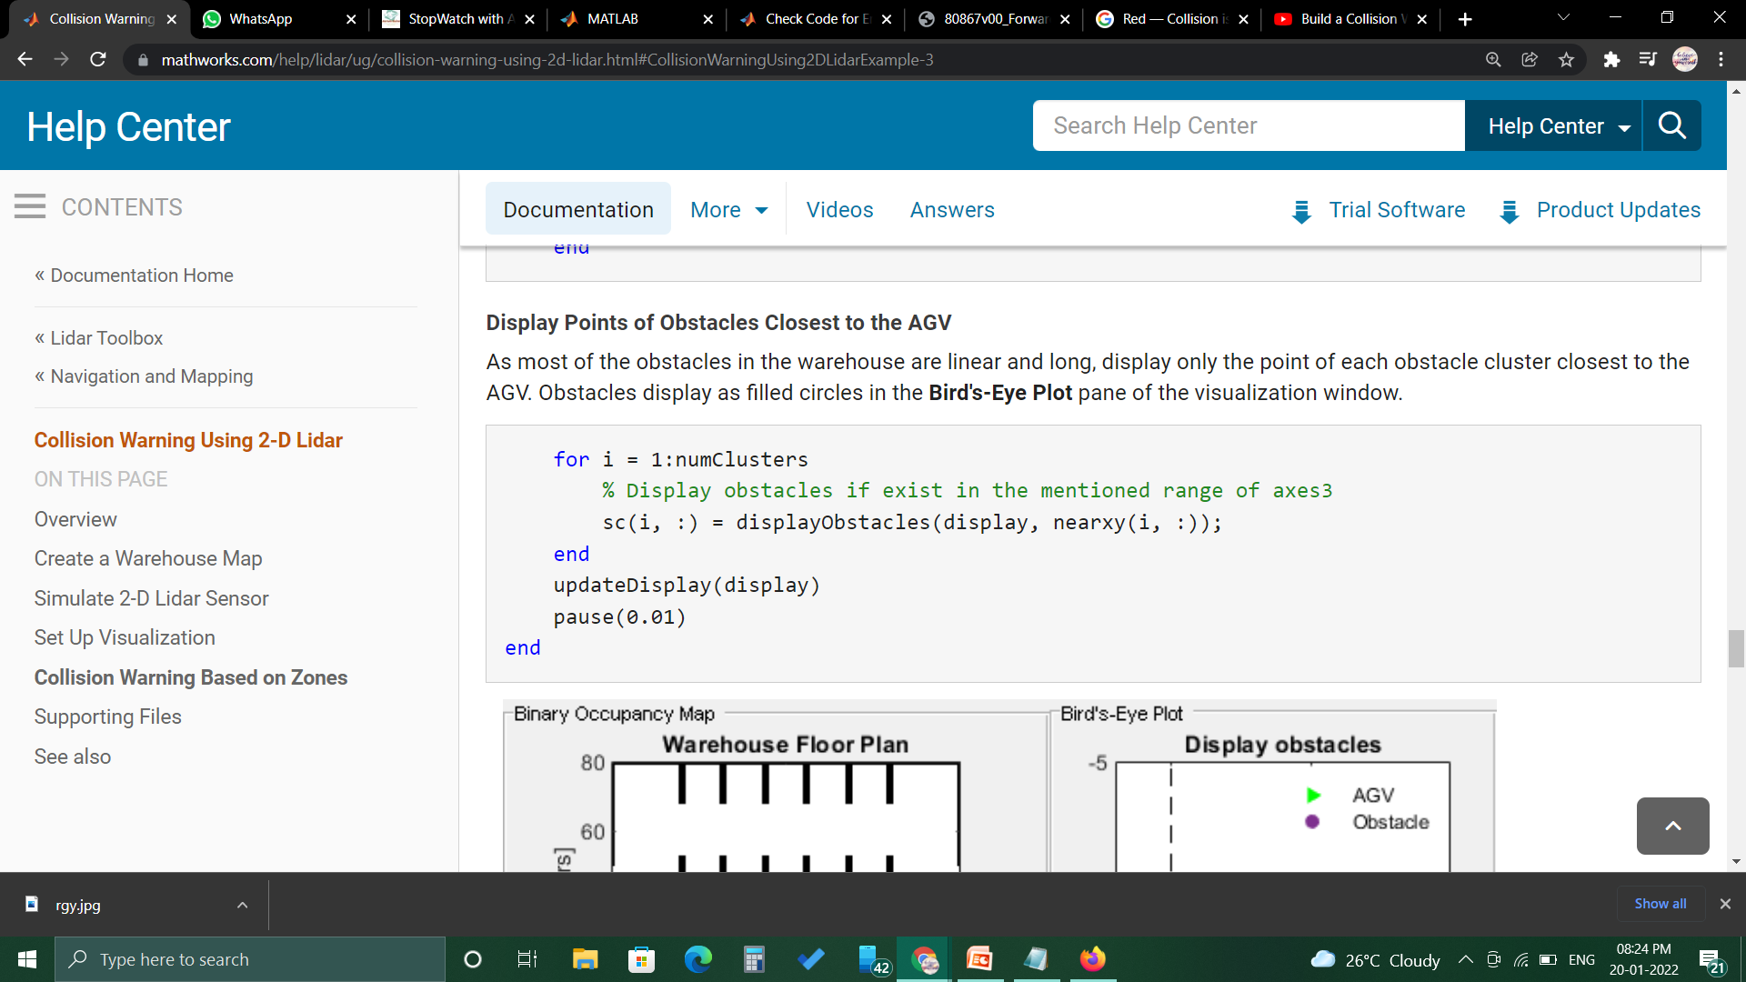
Display Points of Obstacles Closest to the AGV
As most of the obstacles in the warehouse are linear and long, display only the point of each obstacle cluster closest to the AGV.
Obstacles display as filled circles in the Bird's-Eye Plot pane of the visualization window.
CODE:

Slide 28

THANK YOU !

